Slide 1
Learning from Observations
Learning

Slide 2
Course Overview
Introduction
Intelligent Agents
Search
  problem solving through search
  informed search
Games
  games as search problems
Knowledge and Reasoning
  reasoning agents
  propositional logic
  predicate logic
  knowledge-based systems
Learning
  learning from observation
  neural networks
Conclusions
Learning

Slide 3
Chapter Overview Learning
Motivation
Objectives
Learning from Observation
  Learning Agents
  Inductive Learning
  Learning Decision Trees
Computational Learning Theory
  Probably Approximately Correct (PAC) Learning
Learning in Neural Networks
  Neurons and the Brain
  Neural Networks
  Perceptrons
  Multi-layer Networks
  Applications
Important Concepts and Terms
Chapter Summary
Learning

Slide 4
Bridge-In
“knowledge infusion” is not always the best way of providing an agent with knowledge
  impractical, tedious
  incomplete, imprecise, possibly incorrect
adaptivity
  an agent can expand and modify its knowledge base to reflect changes
improved performance
  through learning the agent can make better decisions
autonomy
  without learning, an agent can hardly be considered autonomous
Learning

Slide 5
Motivation
learning is important for agents to deal with
  unknown environments
  changes
the capability to learn is essential for the autonomy of an agent
in many cases, it is more efficient to train an agent via examples, than to “manually” extract knowledge from the examples, and “instill” it into the agent
agents capable of learning can improve their performance
Learning

Slide 6
Objectives
necessity of learning for autonomous agents
understand the basic principles and limitations of inductive learning from examples
apply decision tree learning to deterministic problems characterized by Boolean functions
understand the basic learning methods of perceptrons and multi-layer neural networks
know the main advantages and problems of learning in neural networks
Learning

Slide 7
Learning from Observation
Learning Agents
Inductive Learning
Learning Decision Trees
Learning

Slide 8
Learning Agent Model
Performance
Standard
Sensors
Critic
Feedback
Changes
Learning Element
Knowledge
Performance Element
Learning
Goals
Problem Generator
Agent
Effectors
Environment
Learning

Slide 9
Components Learning Agent
Components Learning Agent
  learning element
  performance element
  critic
  problem generator
responsible for making improvements
uses knowledge about the agent and feedback on its actions to improve performance
Learning

Slide 10
Performance Element
selects external actions
collects percepts, decides on actions
incorporated most aspects of our previous agent design
Learning

Slide 11
Critic
informs the learning element about the performance of the action
must use a fixed standard of performance
  should be from the outside
  an internal standard could be modified to improve performance
    sometimes used by humans to justify or disguise low performance
Learning

Slide 12
Problem Generator
suggests actions that might lead to new experiences
may lead to some sub-optimal decisions in the short run
  in the long run, hopefully better actions may be discovered
otherwise no exploration would occur
Learning

Slide 13
Learning Element Design
selections of the components of the performance elements that are to be improved
representation mechanisms used in those components
availability of feedback
availability of prior information
Learning

Slide 14
Performance Element
multitude of different designs of the performance element
  corresponding to the various agent types discussed earlier
candidate components for learning
  mapping from conditions to actions
  methods of inferring world properties from percept sequences
  changes in the world
  exploration of possible actions
  utility information about the desirability of world states
  goals to achieve high utility values
Learning

Slide 15
Component Representation
many possible representation schemes
  weighted polynomials (e.g. in utility functions for games)
  propositional logic
  predicate logic
  probabilistic methods (e.g. belief networks)
learning methods have been explored and developed for many representation schemes
Learning

Slide 16
Forms of Learning
supervised learning
  an agent tries to find a function that matches examples from a sample set
    each example provides an input together with the correct output
  a teacher provides feedback on the outcome
    the teacher can be an outside entity, or part of the environment
unsupervised learning
  the agent tries to learn from patterns without corresponding output values
reinforcement learning
  the agent does not know the exact output for an input, but it receives feedback on the desirability of its behavior
    the feedback can come from an outside entity, the environment, or the agent itself
    the feedback may be delayed, and not follow the respective action immediately
Learning

Slide 17
Feedback
provides information about the actual outcome of actions
supervised learning
  both the input and the output of a component can be perceived by the agent directly
  the output may be provided by a teacher
reinforcement learning
  feedback concerning the desirability of the agent’s behavior is available
  may not be directly attributable to a particular action
    feedback may occur only after a sequence of actions
  the agent or component knows that it did something right (or wrong), but not what action caused it
Learning

Slide 18
Prior Knowledge
background knowledge available before a task is tackled
can increase performance or decrease learning time considerably
many learning schemes assume that no prior knowledge is available
in reality, some prior knowledge is almost always available
  but often in a form that is not immediately usable by the agent
Learning

Slide 19
Inductive Learning
tries to find a function h (the hypothesis) that approximates a set of samples defining a function f
  the samples are usually provided as
  input-output pairs (x, f(x))
supervised learning method
relies on inductive inference, or induction
  conclusions are drawn from specific instances to more general statements
Learning

Slide 20
Hypotheses
finding a suitable hypothesis can be difficult
  since the function f is unknown, it is hard to tell if the hypothesis h is a good approximation
the hypothesis space describes the set of hypotheses under consideration
  e.g. polynomials, sinusoidal functions, propositional logic, predicate logic, ...
  the choice of the hypothesis space can strongly influence the task of finding a suitable function
  while a very general hypothesis space (e.g. Turing machines) may be guaranteed to contain a suitable function, it can be difficult to find it
Ockham’s razor: if multiple hypotheses are consistent with the data, choose the simplest one
Learning

Slide 21
Example Inductive Learning 1
f(x)
input-output pairs displayed as points in a plane
the task is to find a hypothesis (functions) that connects the points
  either all of them, or most of them
various performance measures
  number of points connected
  minimal surface
  lowest tension
x
Learning

Slide 22
Example Inductive Learning 2
f(x)
x
Learning

Slide 23
Example Inductive Learning 3
f(x)
hypothesis expressed as a polynomial function
incorporates all samples
more complicated to calculate than linear segments
no discontinuities
better predictive power
x
Learning

Slide 24
Example Inductive Learning 4
f(x)
hypothesis is a linear functions
does not incorporate all samples
extremely easy to compute
low predictive power
x
Learning

Slide 25
Inductive Learning Models
Neural Networks
Linear Regression Model
Logistic Regression Model

Slide 26
Neural Networks
complex networks of simple computing elements
capable of learning from examples
  with appropriate learning methods
collection of simple elements performs high-level operations
  thought
  reasoning
  consciousness
Learning

Slide 27
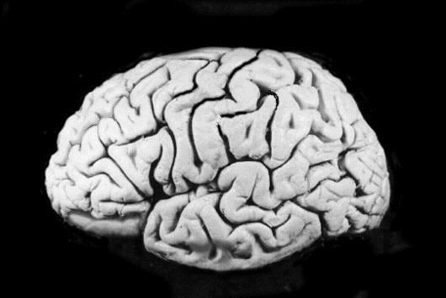
Neural Networks and the Brain
brain
  set of interconnected modules
  performs information processing operations at various levels
    sensory input analysis
    memory storage and retrieval
    reasoning
    feelings
    consciousness
neurons
  basic computational elements
  heavily interconnected with other neurons
[Russell & Norvig, 1995]
Learning

Slide 28
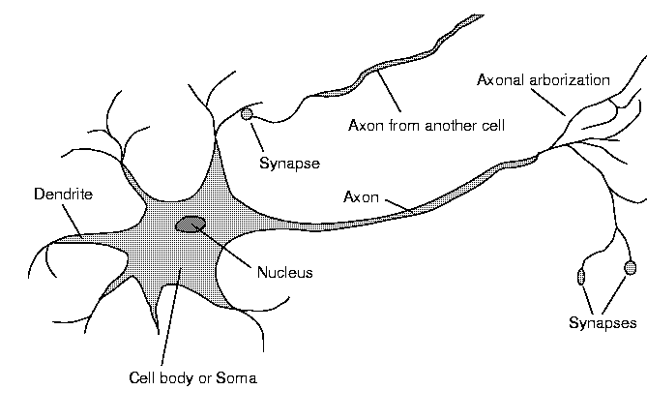
Neuron Diagram
soma
  cell body
dendrites
  incoming branches
axon
  outgoing branch
synapse
  junction between a dendrite and an axon from another neuron
[Russell & Norvig, 1995]
Learning

Slide 29
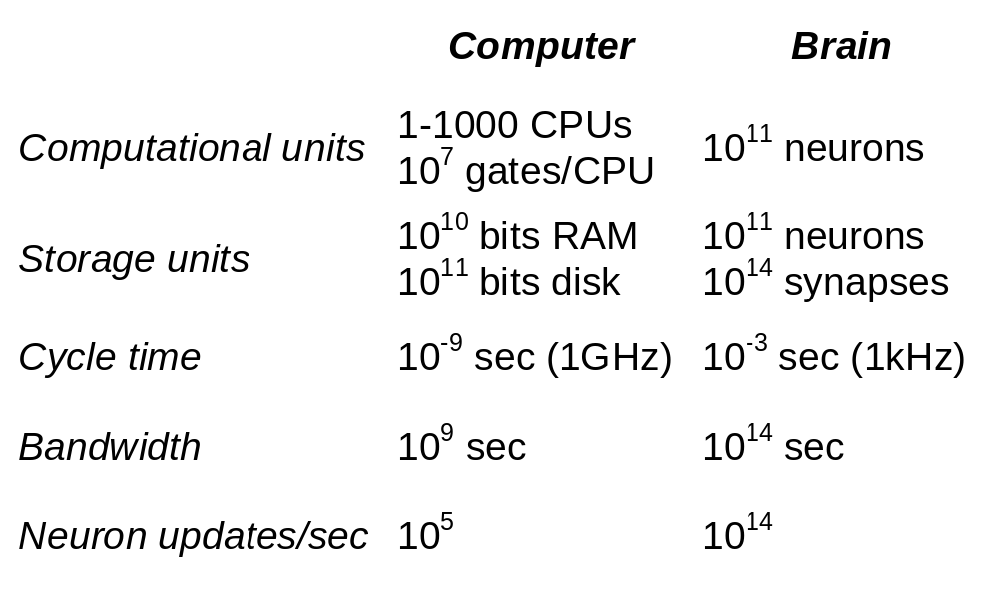
Computer vs. Brain
Learning

Slide 30

Computer Brain vs. Cat Brain
in 2009 IBM makes a supercomputer significantly smarter than cat
  “IBM has announced a software simulation of a mammalian cerebral cortex that's significantly more complex than the cortex of a cat. And, just like the actual brain that it simulates, they still have to figure out how it works.”
http://arstechnica.com/science/news/2009/11/ibm-makes-supercomputer-significantly-smarter-than-cat.ars?utm_source=rss&utm_medium=rss&utm_campaign=rss
http://static.arstechnica.com/cat_computer_ars.jpg
Learning

Slide 31
Google Neural Network
What does a really large NN learn from watching Youtube videos for one week?
NN implementation
  computation spread across 16,000 CPU cores
  more than 1 billion connections in the NN
http://googleblog.blogspot.com/2012/06/using-large-scale-brain-simulations-for.html
Learning

Slide 32
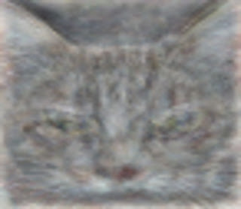
Cat Discovery
“cat” discovery in NN
  learned to identify a category of images with cats
  Google blog post
      https://plus.google.com/u/0/+ResearchatGoogle/posts/EMyhnBetd2F
  published paper
      http://static.googleusercontent.com/external_content/untrusted_dlcp/research.google.com/en/us/archive/unsupervised_icml2012.pdf
http://1.bp.blogspot.com/-VENOsYD1uJc/T-nkLAiANtI/AAAAAAAAJWc/2KCTl3OsI18/s1600/cat+detection.jpeg
Learning

Slide 33
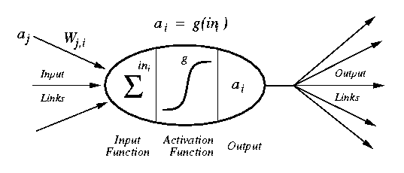
Artificial Neuron Diagram
[Russell & Norvig, 1995]
weighted inputs are summed up by the input function
the (nonlinear) activation function calculates the activation value, which determines the output
Learning

Slide 34
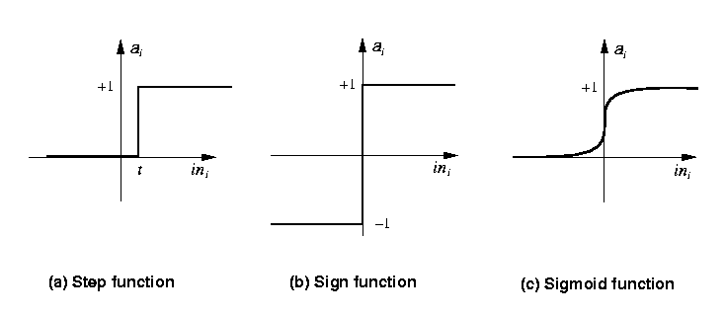
Common Activation Functions
[Russell & Norvig, 1995]
Step_{t}(x) = 1 if x >= t, else 0
Sign(x) = +1 if x >= 0, else –1
Sigmoid(x) = 1/(1+e^{-x})
Learning

Slide 35
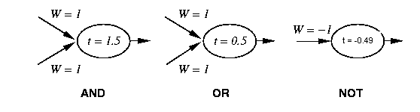
Neural Networks and Logic Gates
[Russell & Norvig, 1995]
simple neurons with can act as logic gates
  appropriate choice of activation function, threshold, and weights
    step function as activation function
Learning

Slide 36
Network Structures
in principle, networks can be arbitrarily connected
  occasionally done to represent specific structures
    semantic networks
    logical sentences
  makes learning rather difficult
layered structures
  networks are arranged into layers
  interconnections mostly between two layers
  some networks have feedback connections
Learning

Slide 37
Chapter Overview Learning
Motivation
Objectives
Learning from Observation
  Learning Agents
  Inductive Learning
  Learning Decision Trees
Computational Learning Theory
  Probably Approximately Correct (PAC) Learning
Learning in Neural Networks
  Neurons and the Brain
  Neural Networks
  Perceptrons
  Multi-layer Networks
  Applications
Important Concepts and Terms
Chapter Summary
Learning

Slide 38
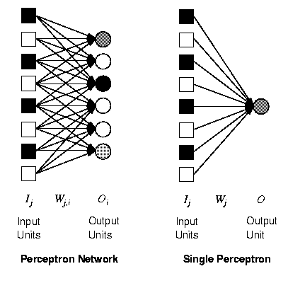
Perceptrons
single layer, feed-forward network
historically one of the first types of neural networks
  late 1950s
the output is calculated as a step function applied to the weighted sum of inputs
capable of learning simple functions
  linearly separable
[Russell & Norvig, 1995]
Learning

Slide 39


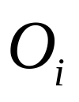
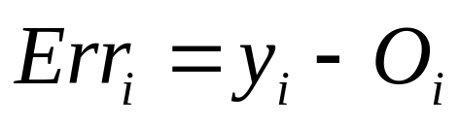
Perceptrons and Learning
x
y
G
S
LM
O
Key concepts: F(x,y), an i.i.d. k-sample on F, functions the equivalent representation of
The difference between the correct output and the model output

Slide 40
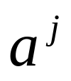
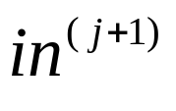
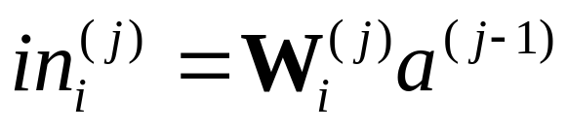
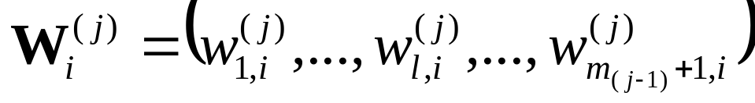
Notation
O_{i}
W_{ji}
Output of j-th layer:
  input of (j+1)-th layer
  Input vector: in⁽⁰⁾
Final output: O_{i}
Weighted sum of i-th sigmoid unit in the j-th layer: in_{i}^{(j)}
Number of sigmoid units in j-th layer: m_{j}
a_{j}
W_{kj}
in_{k}

Slide 41
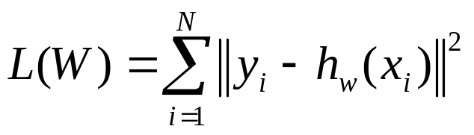
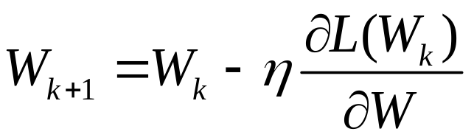
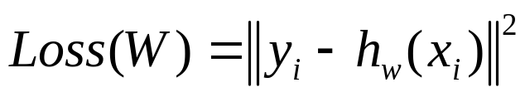
Objective function
O_{i}
Objective function for Training NN
Gradient Descent Algorithm
Loss function
W_{ji}
a_{j}
W_{kj}
in_{k}

Slide 42
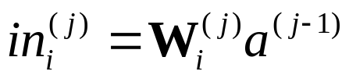
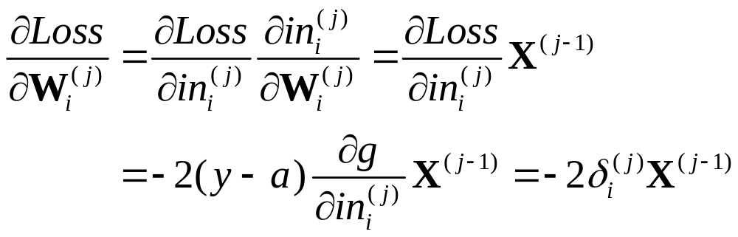
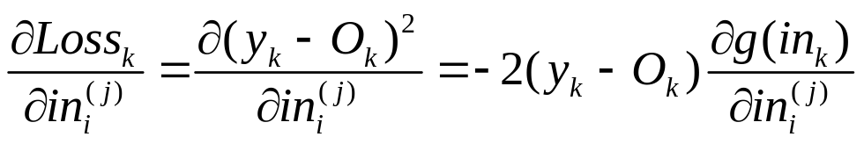
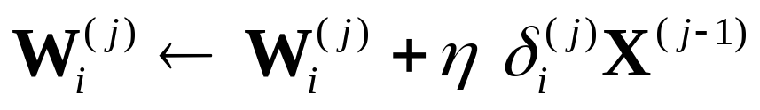
The Backpropagation Method
Gradient of W_{i}^{(j)} :
Weight update:
Local gradient

Slide 43
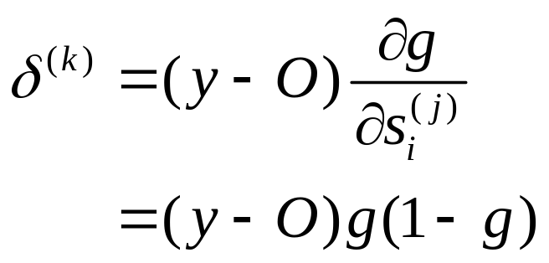
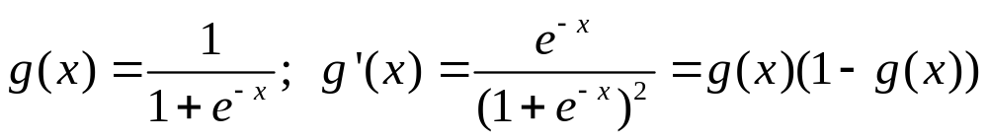
Weight Changes in the Final Layer
Local gradient:
Weight update:
O_{i}
W_{ji}
a_{j}
W_{kj}
in_{k}

Slide 44
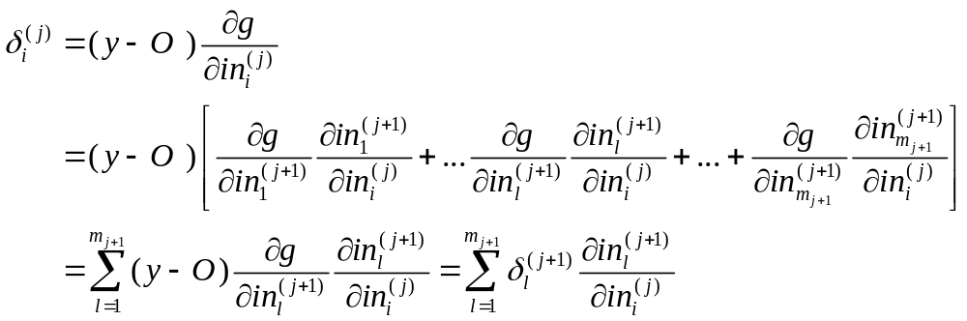
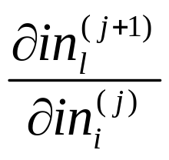
Weights in Intermediate Layers
Local gradient:
  The final ouput h(w) depends on in_{i}^{(j)} through of the summed inputs to the sigmoids in the (j+1)-th layer.
Need for computation of

Slide 45
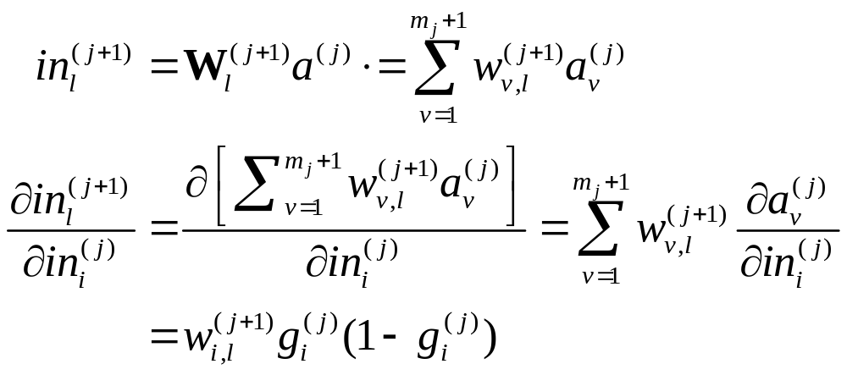
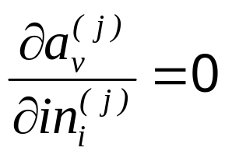
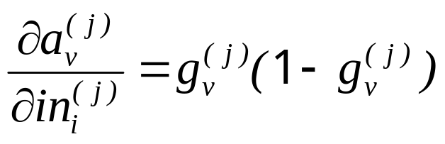
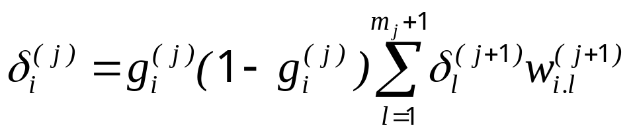
Weight Update in Hidden Layers
  v ≠ i : v = i :
  Conseqeuntly,
O_{i}
W_{ji}
a_{j}
W_{kj}
I_{k}

Slide 46
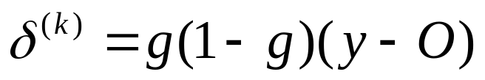

Weight Update in Hidden Layers
Attention to recursive equation of local gradient!
Update algorithm
Backpropagation:
  Error is back-propagated from the output layer to the input layer
  Local gradient of the latter layer is used in calculating local gradient of the former layer.

Slide 47
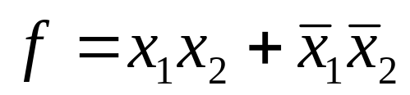
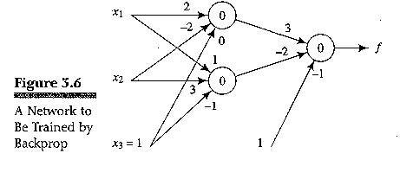
3.3.5 (cont.)
Example (even parity function)
  Learning rate: 1.0
input |  |  | target
1 | 0 | 1 | 0
0 | 0 | 1 | 1
0 | 1 | 1 | 0
1 | 1 | 1 | 1

Slide 48
Generalization, Accuracy, Overfitting
Generalization ability:
  NN appropriately classifies vectors not in the training set.
  Measurement = accuracy
Curve fitting
  Number of training input vectors ≥ number of degrees of freedom of the network.
  In the case of m data points, is (m-1)-degree polynomial best model? No, it can not capture any special information.
Overfitting
  Extra degrees of freedom are essentially just fitting the noise.
  Given sufficient data, the Occam’s Razor principle dictates to choose the lowest-degree polynomial that adequately fits the data.

Slide 49
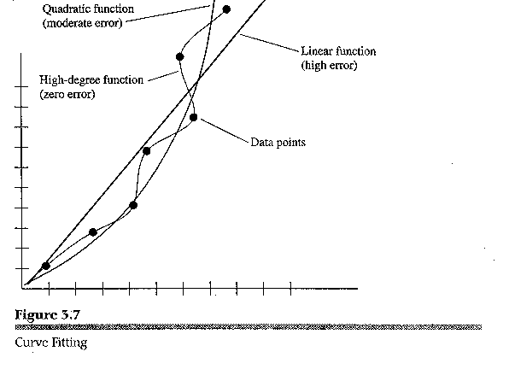
Overfitting

Slide 50
典型应用
计算机视觉
  物体识别、表情识别、动作识别、异常检测、意图识别
语音识别与对话
  低噪音语音识别、复杂场景语音识别、身份与情感识别、领域限定语音交互、语音对话
自然语言理解与交互
  特定领域问答、文本情感与意见挖掘、智能客服、开放领域交互
知识表示与推理
  基于逻辑知识表示、不确定条件下推理推理、概念形成、场景理解
决策与博弈

Slide 51
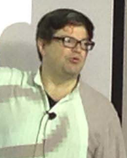

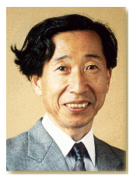

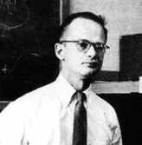

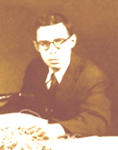
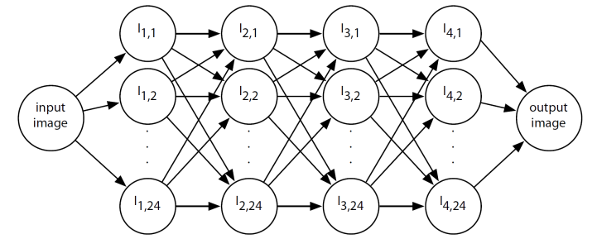
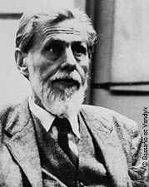
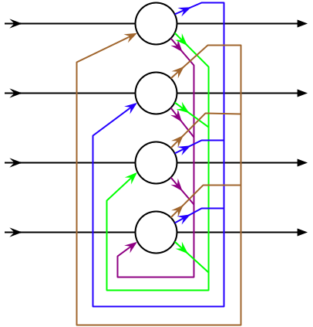
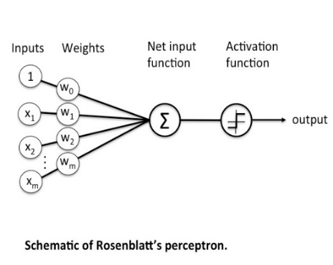
类脑模型进展
CNN, 1998, 2012
RNN, 1982, 2013
S. Amari 1967
S. Grossberg
Deep learning, 2005, 2009
F. Rosenblatt
Hopfield Neural network（1982）
The multilayer perceptron(1972)
Fukushima, Neocognitron(1980)
The perceptron algorithm
（1957）
McCulloch－Pitts′ neuron model
（ 1943 ）

Slide 52
Inductive Learning Models
Neural Networks
Linear Regression Model
Logistic Regression Model

Slide 53
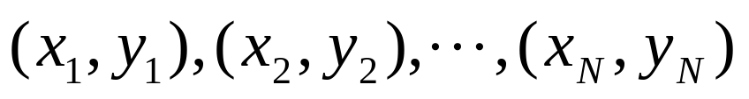


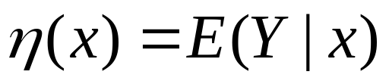
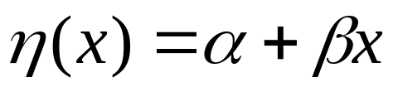
Linear Regression
Data
  is the predictor (regressor, covariate, feature, independent variable)
  is the response (dependent variable, outcome)
We denote the regression function by
The linear regression model assumes a specific linear form for
which is usually thought of as an approximation to the truth.

Slide 54
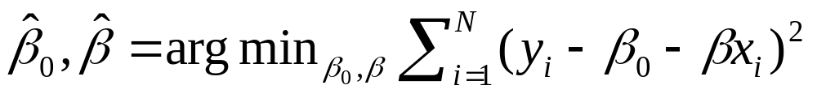
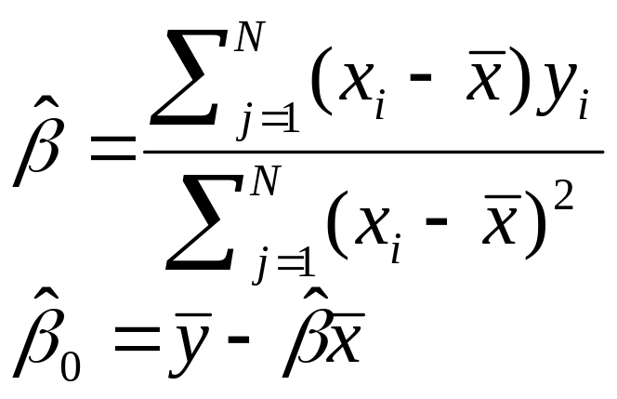
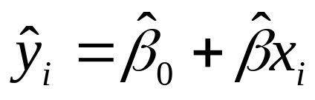
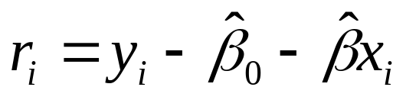
Fitting by least squares
Minimize:
Solutions are
are called the fitted or predicted values
are called the residuals
Linear Methods for Regression

Slide 55
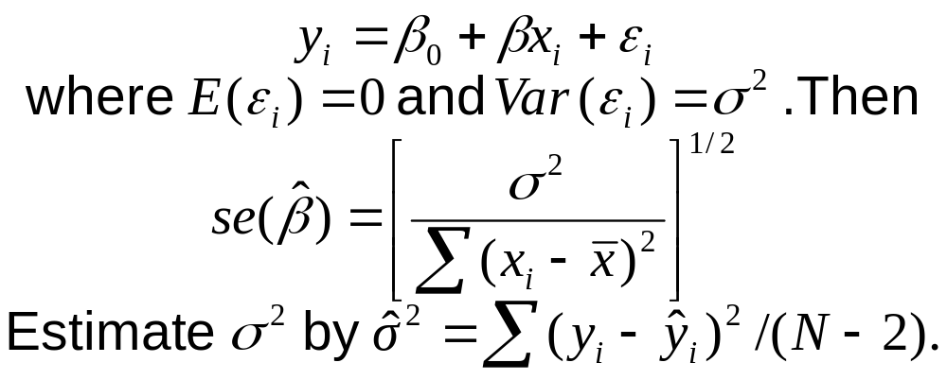
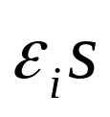


Confidence intervals
We often assume further that
Under additional assumption of normality for the , a 95% confidence interval for is:

Slide 56


Fitted regression line with pointwise standard errors:
Linear Methods for Regression

Slide 57



Multiple linear regression
Model is
Equivalently in matrix notation:
f is N-vector of predicted values
X is N × p matrix of regresses, with ones in the first column
is a p-vector of parameters

Slide 58


Estimation by least squares

Slide 59
Inductive Learning Models
Neural Networks
Linear Regression Model
  Linear Regression for Classification
Logistic Regression Model

Slide 60

Logistic Regression
Model:

Slide 61



Logistic Regression con’t
Parameters estimation
  Objective function
  Parameters estimation
    IRLS (iteratively reweighted least squares)
    Particularly, for two-class case, using Newton-Raphson algorithm to solve the equation, the objective function:

Slide 62



Logistic Regression con’t

Slide 63

Logistic Regression con’t

Slide 65
Learning and Decision Trees
Input： a set of attributes；Output: predicted value
  classification learning for discrete values
  regression for continuous values
Boolean or binary classification
  output values are true or false
  conceptually the simplest case, but still quite powerful
Making decisions
  a sequence of test is performed, testing the value of one of the attributes in each step
  when a leaf node is reached, its value is returned
  good correspondence to human decision-making
Learning

Slide 66
Boolean Decision Trees
Compute yes/no decisions based on sets of desirable or undesirable properties of an object or a situation
  each node in the tree reflects one yes/no decision based on a test of the value of one property of the object
    the root node is the starting point
    leaf nodes represent the possible final decisions
  branches are labeled with possible values
The learning aspect is to predict the value of a goal predicate (also called goal concept)
  a hypothesis is formulated as a function that defines the goal predicate
Learning

Slide 67

The wait@restaurant decision tree
This is our true function.
Can we learn this tree from examples?

Slide 68
Terminology
Example or sample
  describes the values of the attributes and the goal
    a positive sample has the value true for the goal predicate, a negative sample false
Sample set
  collection of samples used for training and validation
Training
  the training set consists of samples used for constructing the decision tree
Validation
  the test set is used to determine if the decision tree performs correctly
    ideally, the test set is different from the training set
Learning

Slide 69
Question?
Let’s look at a classification problem: predicting whether a certain person will choose a particular restaurant.

Slide 70
Decision tree learning example
10 attributes:
Alternate: Is there a suitable alternative restaurant nearby? {yes,no}
Bar: Is there a bar to wait in? {yes,no}
Fri/Sat: Is it Friday or Saturday? {yes,no}
Hungry: Are you hungry? {yes,no}
Patrons: How many are seated in the restaurant? {none, some, full}
Price: Price level {$,$$,$$$}
Raining: Is it raining? {yes,no}
Reservation: Did you make a reservation? {yes,no}
Type: Type of food {French,Italian,Thai,Burger}
Wait: {0-10 min, 10-30 min, 30-60 min, >60 min}

Slide 71

Decision tree learning example

Slide 72
Method: Decision trees
“Divide and conquer”:
Split data into smaller and smaller subsets.
Splits usually on a single variable
x₁ > α ?
yes
no
x₂ > β ?
x₂ > γ ?
yes
no
yes
no

Slide 73

Inductive learning of decision tree
Simplest: Construct a decision tree with one leaf for every example = memory based learning.
Not very good generalization.
Advanced: Split on each variable so that the purity of each split increases (i.e. either only yes or only no)
Purity measured,e.g, with entropy
General form:

Slide 74


The entropy is maximal when all possibilities are equally likely.
The goal of the decision tree is to decrease the entropy in each node.
Entropy is zero in a pure ”yes” node (or pure ”no” node).
Entropy is a measure of ”order” in a
system.
The second law of thermodynamics:
Elements in a closed system tend to seek their most probable distribution; in a closed system entropy always increases

Slide 75


Decision tree learning algorithm
Create pure nodes whenever possible
If pure nodes are not possible, choose the split that leads to the largest decrease in entropy.

Slide 76

Decision tree learning example
T = True, F = False
6 True,
6 False

Slide 77
Decision tree learning example
Alternate?
Yes
No
3 T, 3 F
3 T, 3 F
Entropy decrease = 0.30 – 0.30 = 0

Slide 78
Decision tree learning example
Bar?
Yes
No
3 T, 3 F
3 T, 3 F
Entropy decrease = 0.30 – 0.30 = 0

Slide 79
Decision tree learning example
Sat/Fri?
Yes
No
2 T, 3 F
4 T, 3 F
Entropy decrease = 0.30 – 0.29 = 0.01

Slide 80
Decision tree learning example
Hungry?
Yes
No
5 T, 2 F
1 T, 4 F
Entropy decrease = 0.30 – 0.24 = 0.06

Slide 81
Decision tree learning example
Raining?
Yes
No
2 T, 2 F
4 T, 4 F
Entropy decrease = 0.30 – 0.30 = 0

Slide 82
Decision tree learning example
Reservation?
Yes
No
3 T, 2 F
3 T, 4 F
Entropy decrease = 0.30 – 0.29 = 0.01

Slide 83

Decision tree learning example
Patrons?
None
Full
2 F
Some
2 T, 4 F
4 T
Entropy decrease = 0.30 – 0.14 = 0.16

Slide 84

Decision tree learning example
Price
$
$$$
3 T, 3 F
$$
1 T, 3 F
2 T
Entropy decrease = 0.30 – 0.23 = 0.07

Slide 85

Decision tree learning example
Type
French
Burger
1 T, 1 F
2 T, 2 F
Italian
Thai
1 T, 1 F
2 T, 2 F
Entropy decrease = 0.30 – 0.30 = 0

Slide 86

Decision tree learning example
Est. waiting
time
0-10
> 60
4 T, 2 F
2 F
10-30
30-60
1 T, 1 F
1 T, 1 F
Entropy decrease = 0.30 – 0.24 = 0.06

Slide 87
Decision tree learning example
Patrons?
Largest entropy decrease (0.16)
achieved by splitting on Patrons.
None
Full
2 F
Some
2 T, 4 F
X?
4 T
Continue like this, making new splits, always purifying nodes.

Slide 88

Decision tree learning example
Induced tree (from examples)

Slide 89
Decision tree learning example
True tree

Slide 90
Decision tree learning example
Induced tree (from examples)
Cannot make it more complex
than what the data supports.

Slide 91
How do we know it is correct?
How do we know that h ≈ f ?
(Hume's Problem of Induction)
  Try h on a new test set of examples
  (cross validation)
...and assume the ”principle of uniformity”, i.e. the result we get on this test data should be indicative of results on future data. Causality is constant.

Slide 92

Learning curve for the decision tree algorithm on 100 randomly
generated examples in the restaurant domain.
The graph summarizes 20 trials.

Slide 93

Cross-validation
Use a “validation set”.
Split your data set into two
parts, one for training your
model and the other for
validating your model.
The error on the validation
data is called “validation error”
(E_{val})
D_{train}
D_{val}
E_{val}

Slide 94

K-Fold Cross-validation
More accurate than using only one validation set.
D_{train}
D_{val}
D_{train}
D_{val}
D_{train}
D_{val}
D_{train}
E_{val}(1)
E_{val}(2)
E_{val}(3)

Slide 95
Question?
If the total number of training sample is small, how can we conduct the cross-validation?

Slide 96
Ockham’s Razor
The most likely hypothesis is the simplest one that is consistent with all observations.
  general principle for inductive learning
  a simple hypothesis that is consistent with all observations is more likely to be correct than a complex one
Learning

Slide 97
Constructing Decision Trees
in general, constructing the smallest possible decision tree is an intractable problem
algorithms exist for constructing reasonably small trees
basic idea: test the most important attribute first
  attribute that makes the most difference for the classification of an example
    can be determined through information theory
  hopefully will yield the correct classification with few tests
Learning

Slide 98
Performance of DT Learning
Quality of predictions
  predictions for the classification of unknown examples that agree with the correct result are obviously better
  can be measured easily after the fact
  it can be assessed in advance by splitting the available examples into a training set and a test set
    learn the training set, and assess the performance via the test set
Size of the tree
  a smaller tree (especially depth-wise) is a more concise representation
Learning

Slide 99
Noise and Over-fitting
The presence of irrelevant attributes (“noise”) may lead to more degrees of freedom in the decision tree
  the hypothesis space is unnecessarily large
Overfitting makes use of irrelevant attributes to distinguish between samples that have no meaningful differences
  e.g. using the day of the week when rolling dice
  over-fitting is a general problem for all learning algorithms
Decision tree pruning identifies attributes that are likely to be irrelevant
Cross-validation splits the sample data in different training and test sets
  results are averaged
Learning

Slide 100
Ensemble Learning
multiple hypotheses (an ensemble) are generated, and their predictions combined
  by using multiple hypotheses, the likelihood for misclassification is hopefully lower
  also enlarges the hypothesis space
boosting is a frequently used ensemble method
  each example in the training set has a weight associated
  the weights of incorrectly classified examples are increased, and a new hypothesis is generated from this new weighted training set
  the final hypothesis is a weighted-majority combination of all the generated hypotheses
Learning

Slide 101
Computational Learning Theory
Relies on methods and techniques from theoretical computer science, statistics, and AI
The formal analysis of learning algorithms
Basic principles
  a hypothesis is seriously wrong
    it will most likely generate a false prediction even for small numbers of examples
  hypothesis is consistent with a large number of examples
    most likely it is quite good, or probably approximately correct
Learning

Slide 102
Learning in Neural Networks
Neurons and the Brain
Neural Networks
Perceptrons
Multi-layer Networks
Applications
Learning

Slide 103
Chapter Summary
learning is very important for agents to improve their decision-making process
  unknown environments, changes, time constraints
most methods rely on inductive learning
  a function is approximated from sample input-output pairs
decision trees are useful for learning deterministic Boolean functions
neural networks consist of simple interconnected computational elements
multi-layer feed-forward networks can learn any function
  provided they have enough units and time to learn
Learning

